Slide 1
Predicting Taxi Ride Prices
Sven Durchholz
Leonard Schmischke

Slide 2
What is the data about?
100,000 click logs from users from an on-line shopping website
Train set: 7 days
Test set: last day
Ad_features: additional information about the ads shown to the user
User_profile: additional user information for users from the train set and others
Behavior_log: shopping behavior of users in the last 22 days

Slide 3
Outlier detection
High prices
Duplicate entries in behavior_log
NaNs in
brand
pvalue_level
new_user_class_level
-(average money spent?), actions?

Slide 4
Scenarios
When do people click on ads?
High interest in product category/brand
Ad advertises a bargain
Ad advertises a product that belongs to an earlier buy
When they have a lot of money to spend (start of a month?)
When they are easily manipulated (/drunk) -> in the evening/weekends?
When the ad itself is well made and interesting
When the person historically clicks on many ads
When do people not click on ads?
(nearly) everytime
When they clicked the ad before, ad provides no new information
When an add shows a price that is too far away from the usual shopping behavior

Slide 5
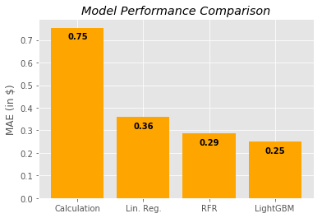
Modelling approach
Can be used for rate code 1 and 3
Rate code 2?
Rate code 5?
Rate code 4?

Slide 6
Problems
Assumption 1: Bridge that minimize air-line distance is actually used
Different route
Non-linear route
Assumption 2: air-line distance ratio represents real inner-city to outer-city trip distance ratio
Different shape of route in city vs out of city
Extra destinations possible

Slide 7
Extra Prediction - Calculation
MAE:
0.006

Slide 8
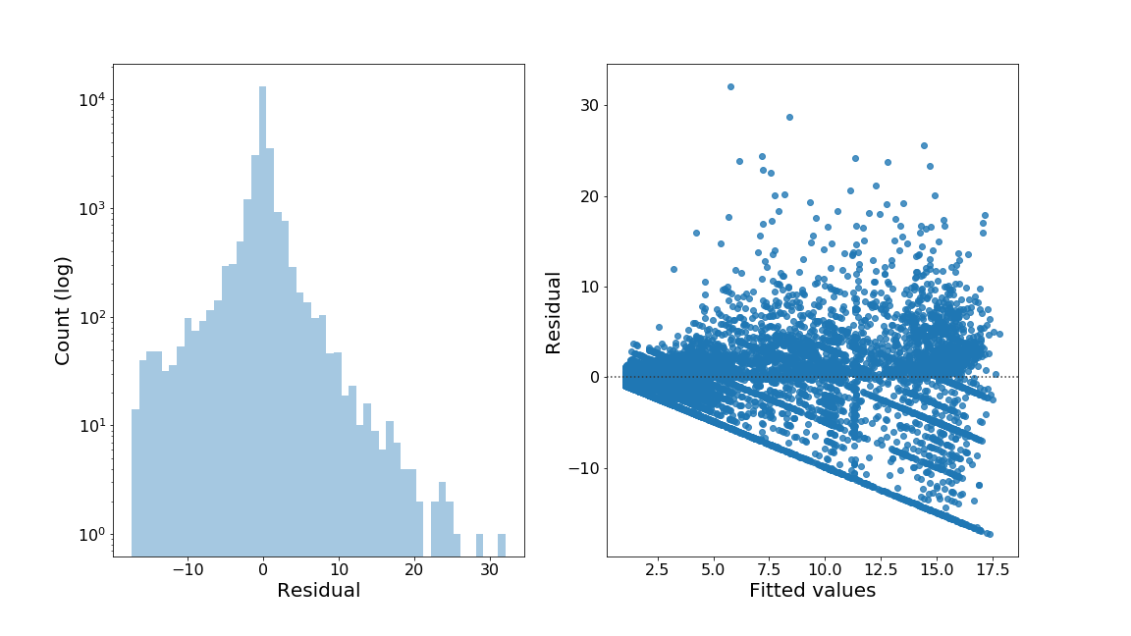
Tip Prediction - Evaluation

Slide 9
Retrospective
Use full user_profile information
Good ideas, bad execution
Biased features

